Slide 1
Google Certified Professional Data Enginer
Presenter
Nikhil Shah

Slide 2
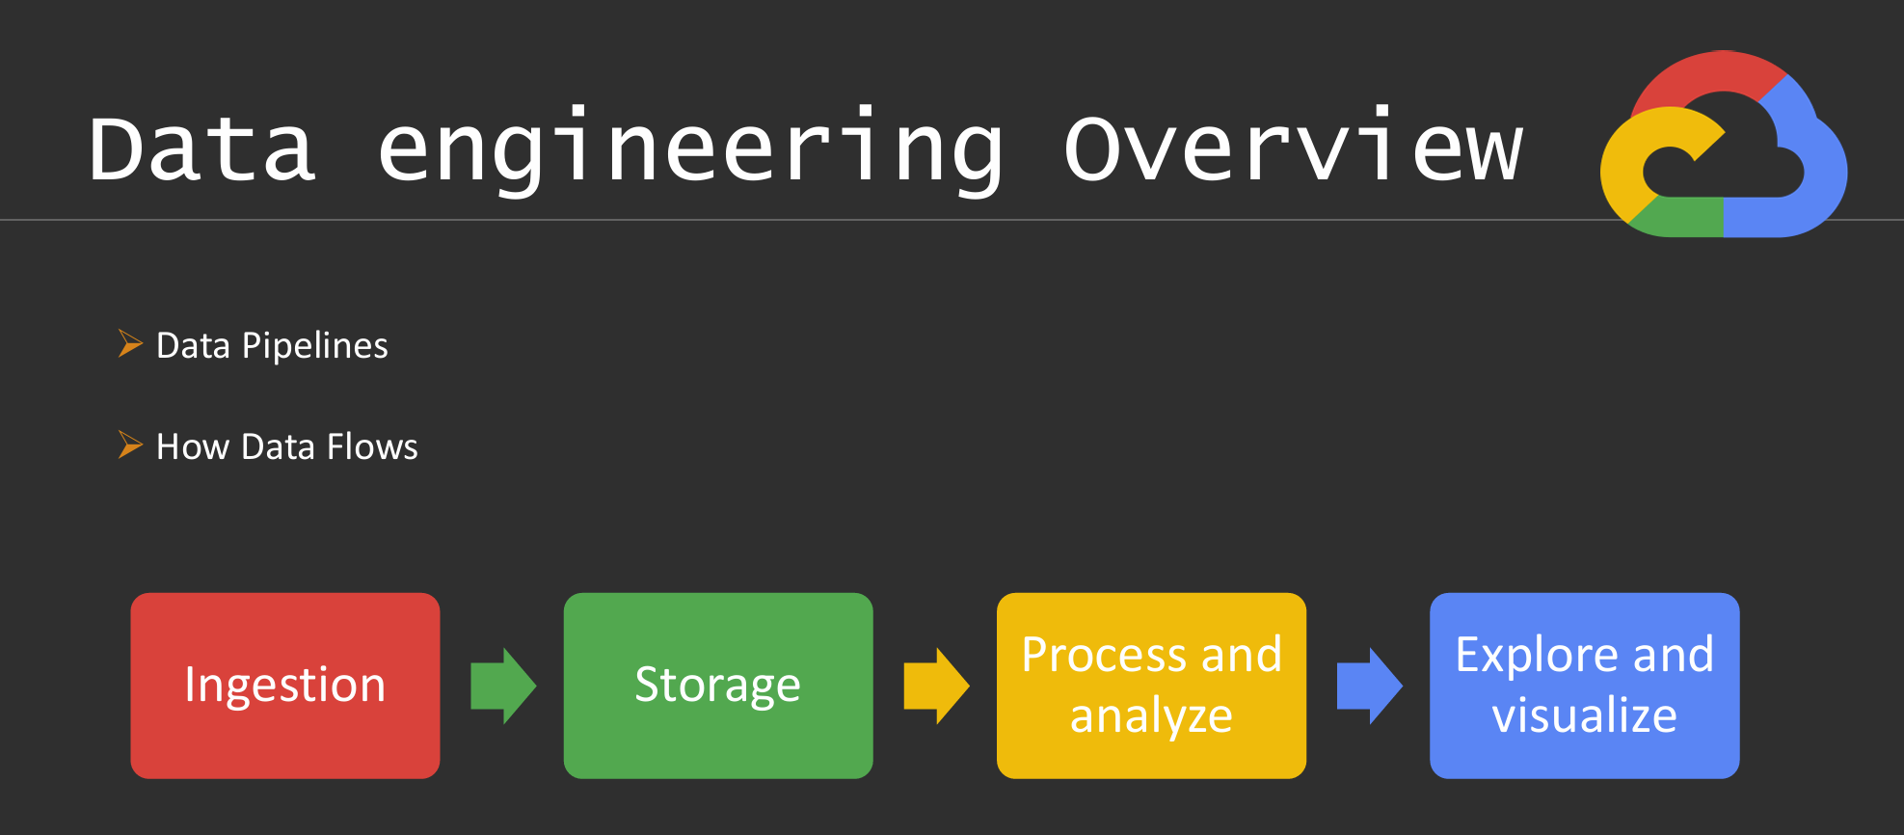
Presenter :
Nikhil Shah

Slide 3
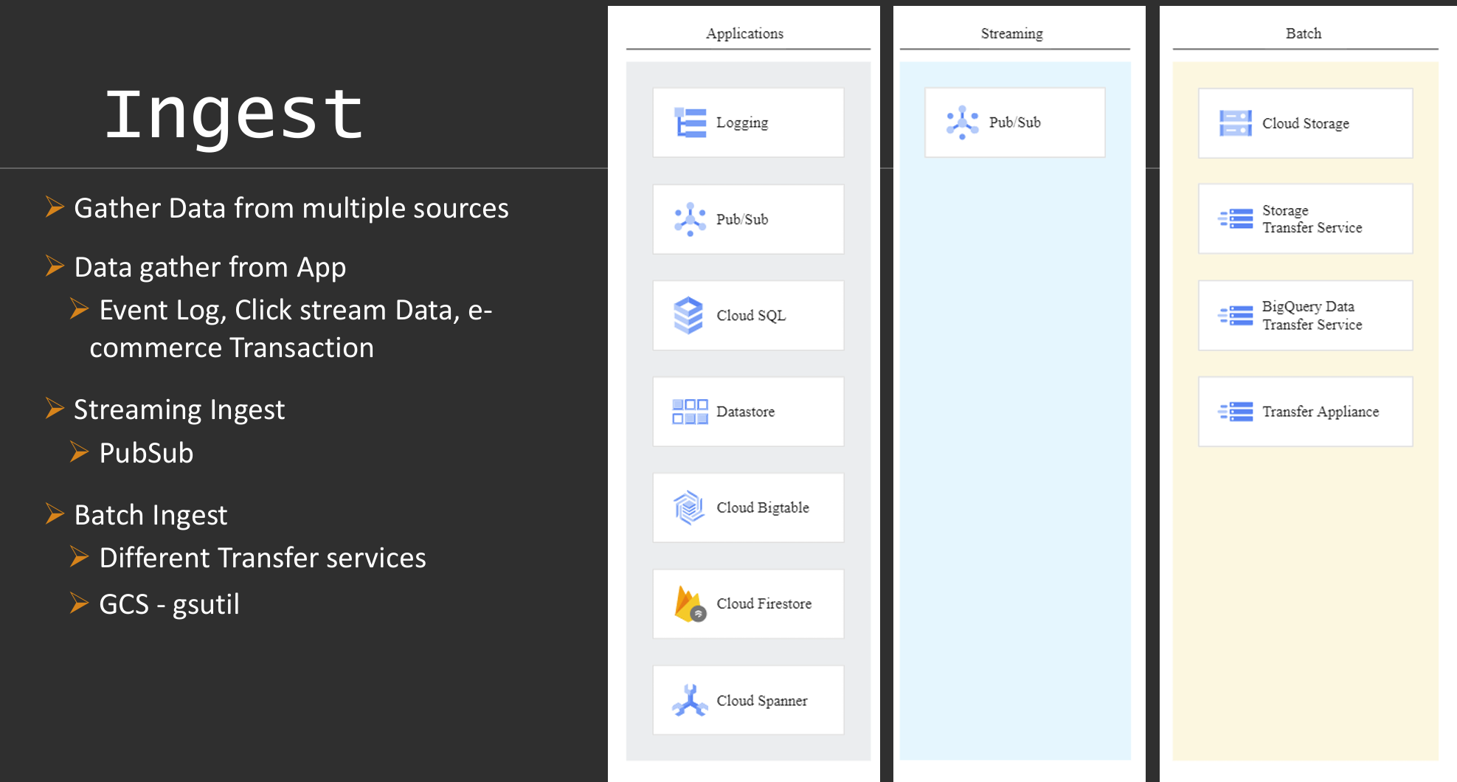

Slide 4
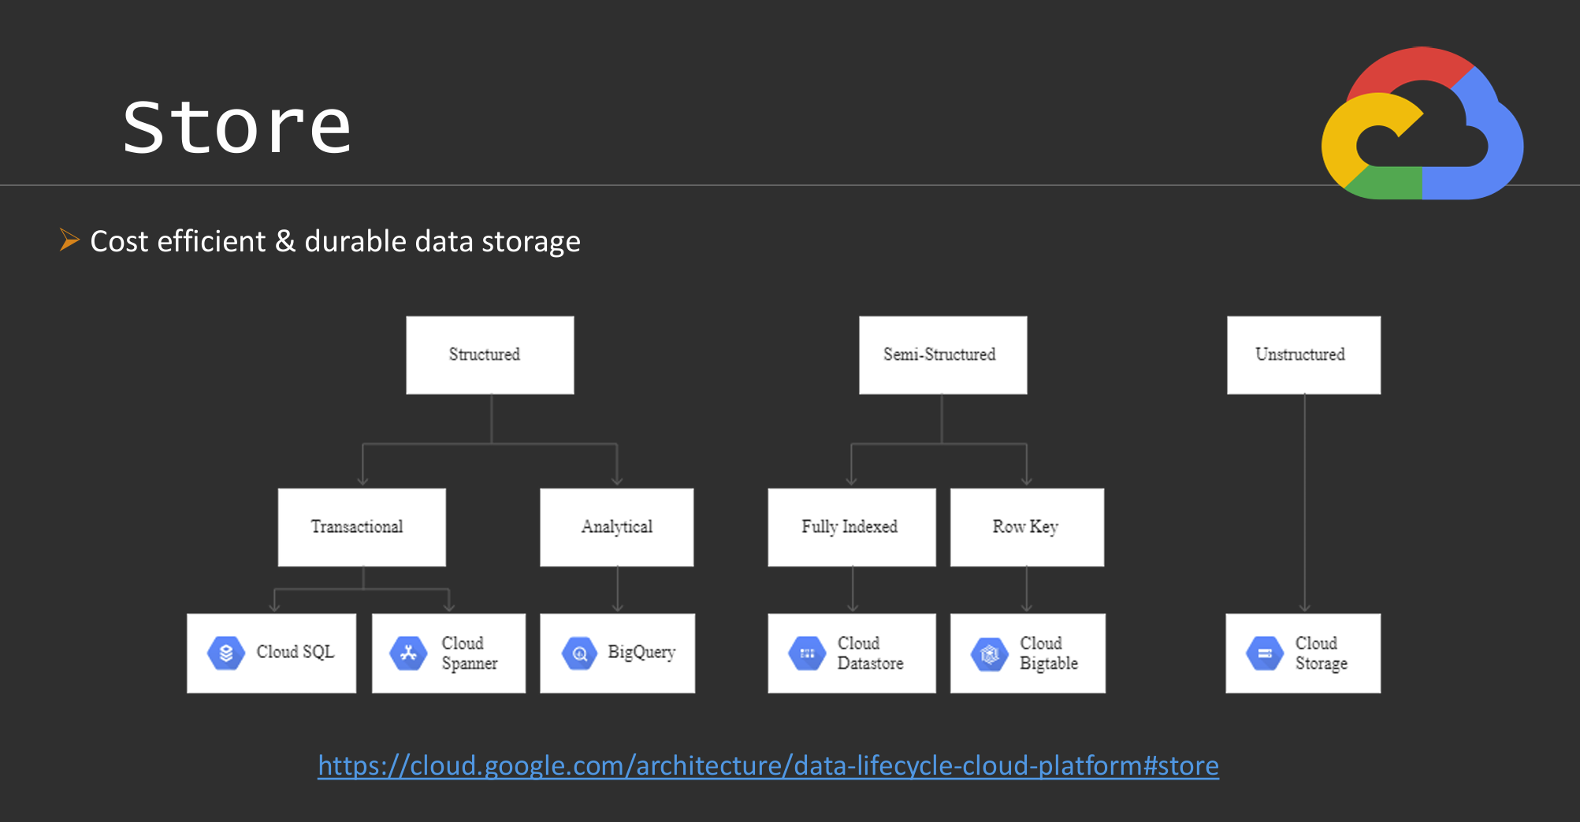

Slide 5
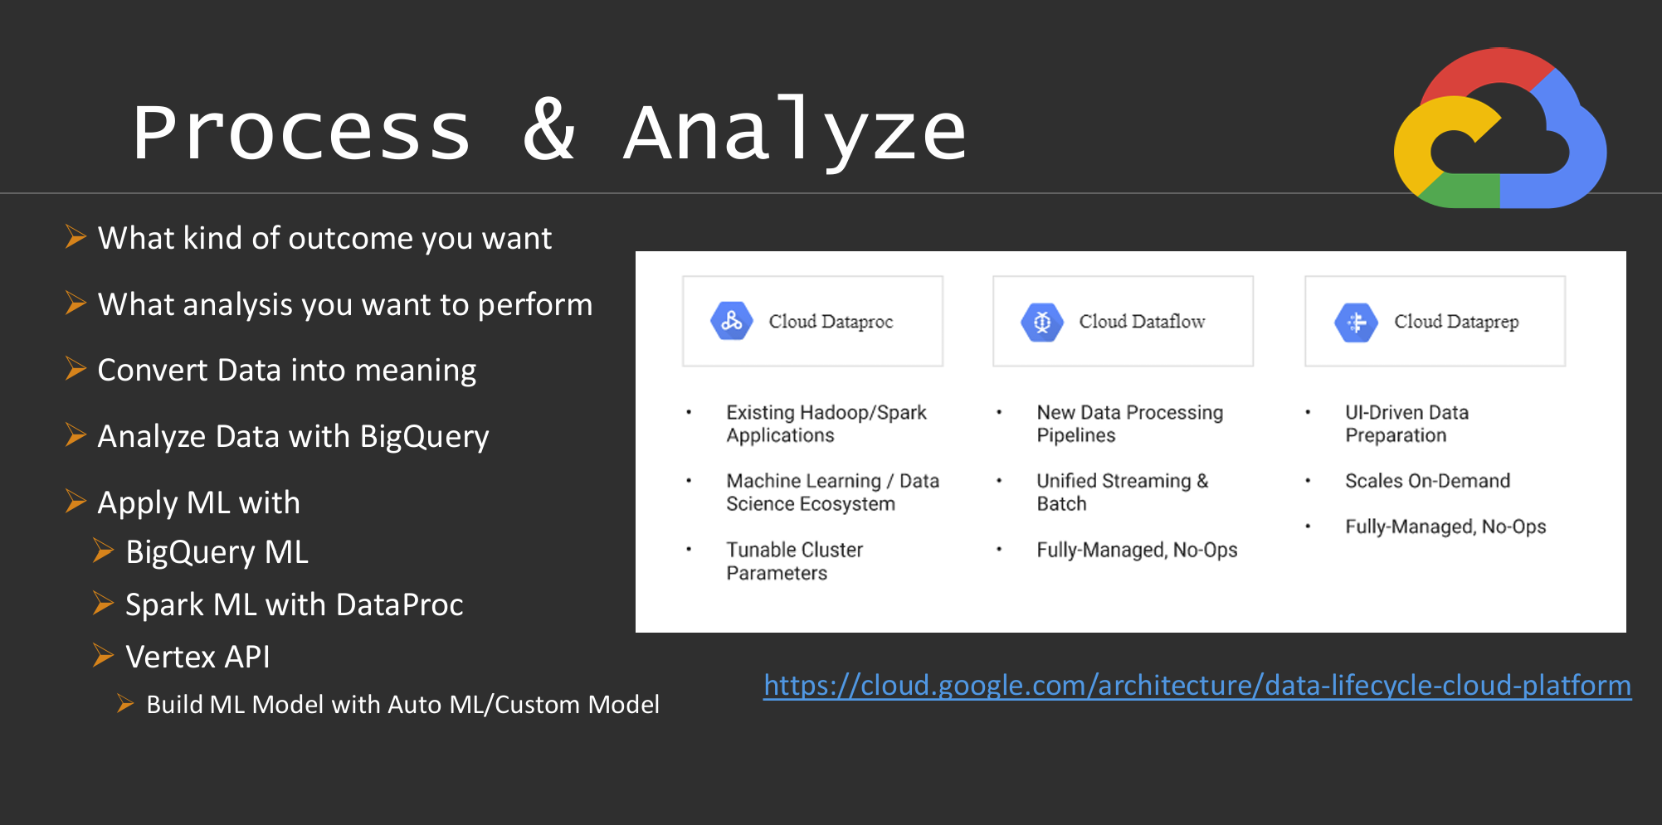

Slide 6
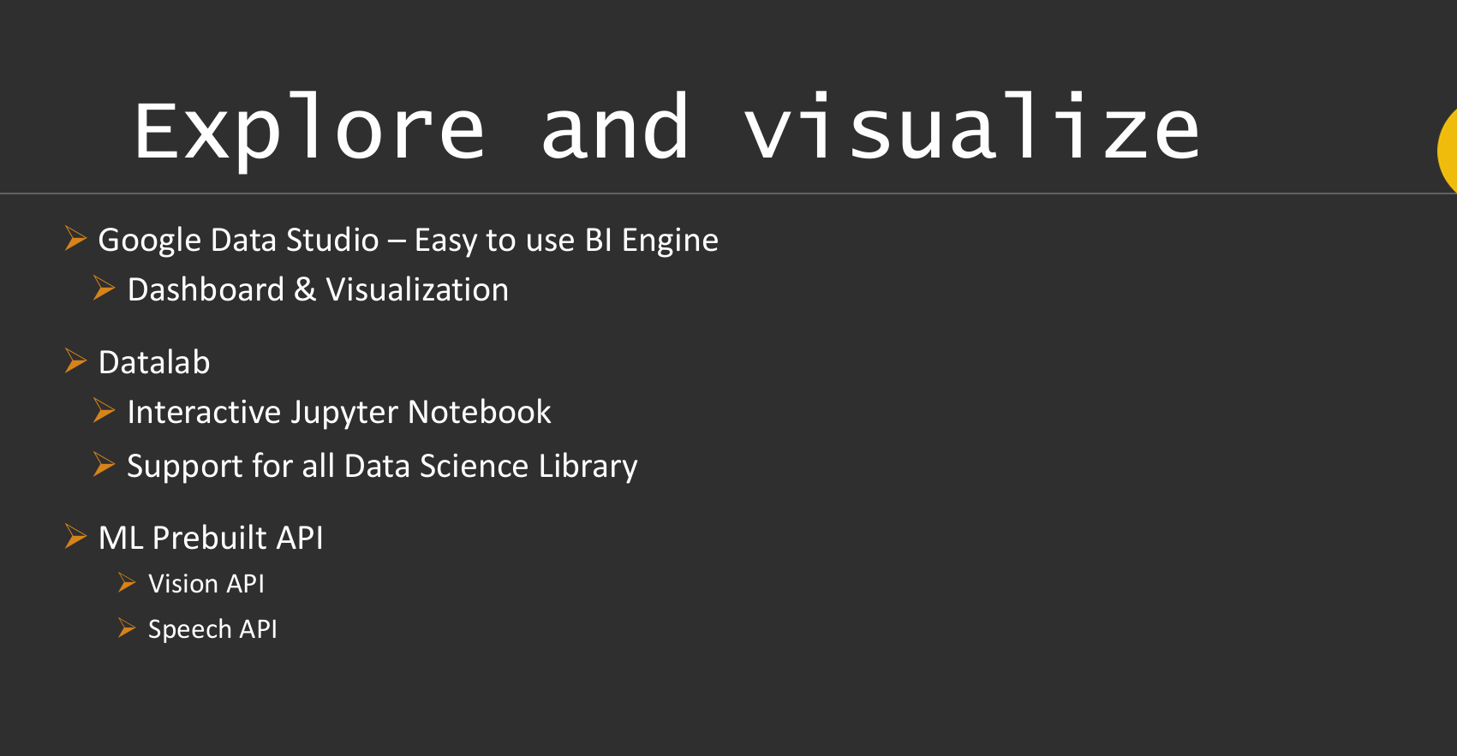

Slide 7
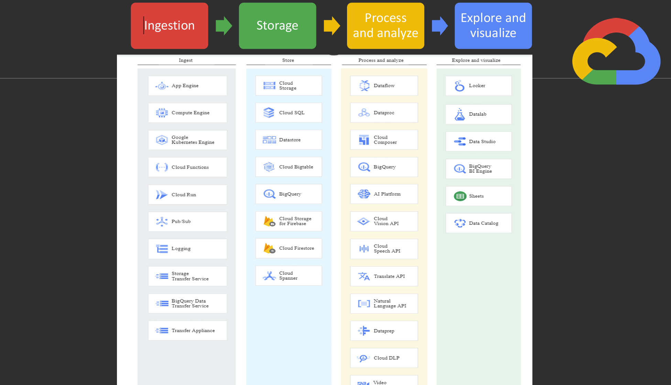

Slide 8
Thank you - all the best
Nikhil Shah

